Slide 1
Artificial Intelligence
School of computer science
Huazhong university of science and technology
冯琪

Slide 2
Lecture 2 Problem Solving by searching

Slide 3
Outline - Lecture 02
Problem Solving
Search
Graph Search - Review
Heuristic Search
State Space
Discussion: Where is the intelligence in searching

Slide 4
Problem Solving

Slide 5
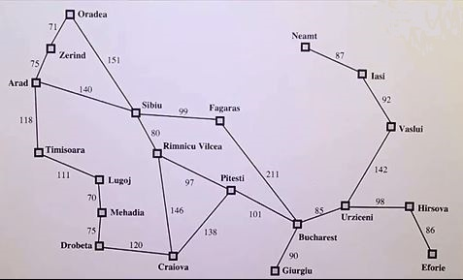
Deﬁnition of Problem
The initial state ：
the agent starts in
the possible actions ：
available to the agent
transit current state to a new state
The goal state ：
the agent ends in
The goal test:
determines whether a given state is a goal state
A path and path cost :
from initial state to goal state
a numeric cost to each path

Slide 6
Definition by State Space method
Initial State: s_{o}
Goal State: s_{g}
Actions available to the agent: ACTIONS(s) : {a₁, a₂, …} (s : state)
the transition model: RESULT(s, a) → s’ (s’: new state)
The goal test: GOALTEST(s) → F | T (s : state)
A path cost : PATHCOST(path) → n

Slide 7
Problem solving
In the state space
finding a path
from initial state to goal state
with minimum cost or Satisfactory cost

Slide 8
The feature of the Problem in this lecture
addressed a single category of problems:
observable, deterministic, known environments
where the solution is a sequence of actions
The search algorithms explore search spaces systematically.
This systematicity is achieved by
keeping one or more paths in memory
recording which alternatives have been explored at each point along the path.
When a goal is found, the path to that goal also constitutes a solution to the problem.

Slide 9
Example problem 1：Finding Path in map
initial: Arad
goal: Bucharest
√
√

Slide 10
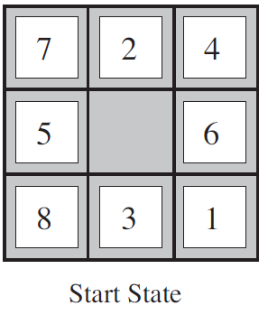
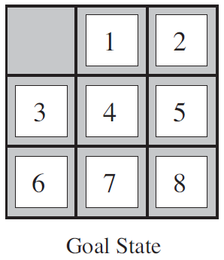
Example problem 2： 8-puzzle

Slide 11
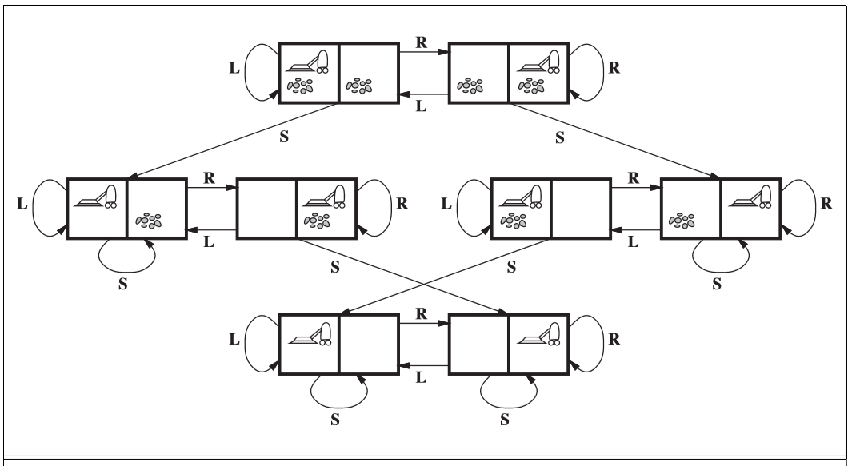
Example problem 3：the vacuum world

Slide 12
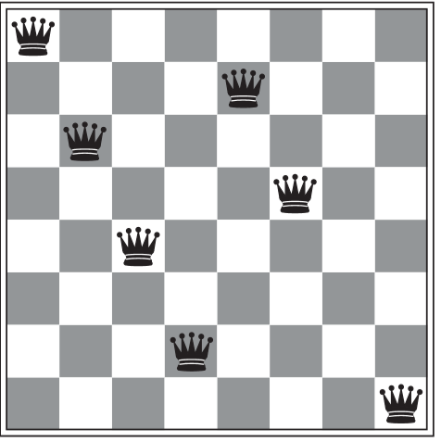
Example problem 4： 8-queens problem

Slide 13
Solving ：graph search
√
Arad
1，the problem is described in a graph
2，searching the graph
to find the path
from initial node
to goal node
by using some searching algorithm
Zerind
sibiu
timiso
oradea
fagaras
Rimnicu
Lugoj
pitests
mehadia
√
drobeta
Bucharest
giurgiu
urziceni
craiova
hirsova
vaslui
eforie
Iasi
neamt

Slide 14
Searching method

Slide 15
Search Strategies
uninformed search (blind search)
the strategies have no additional information about states beyond that provided in the problem deﬁnition.
All they can do is generate successors and distinguish a goal state from a non-goal state.
informed search (heuristic search)
The strategies use problem-specific knowledge beyond the definition of the problem itself
they know whether one non-goal state is “more promising” than another
They can find solutions more efficiently than an uninformed strategy.

Slide 16
blind search ： Breadth First Search
Open: Arad
Close:
Create two table
Open table: for nodes to be expanded
Close table: for nodes expanded
Initial step
Expand initial node

Slide 17
blind search ： Breadth First Search
Open:
Zerind
Sibiu
Timisoara
Close:
Arad
Goal test the first node in Open table
if it is the goal, then the algorithm should be terminated
Expand it and then move from Open to Close.
Put it’s descendents into open table

Slide 18
blind search ： Breadth First Search
Open:
Sibiu
Timisoara
Oradea
Close:
Arad
Zerind
In the same level of a tree，we expand nodes in order from left to right

Slide 19
blind search ： Breadth First Search
Open:
Timisoara
Oradea
Fagras
Rimnicu
Close:
Arad
Zerind
Sibiu
When a node meets a new parent node, it needs to determine whether to change it’s parent node

Slide 20
blind search ： Breadth First Search
Open:
Oradea
Fagras
Rimnicu
Lugoj
Close:
Arad
Zerind
Sibiu
Timisoara

Slide 21
blind search ： Breadth First Search
Open:
Fagras
Rimnicu
Lugoj
Close:
Arad
Zerind
Sibiu
Timisoara
Oradea

Slide 22
blind search ： Breadth First Search
Open:
Rimnicu
Lugoj
Bucharest
Close:
Arad
Zerind
Sibiu
Timisoara
Oradea
Fagras

Slide 23
blind search ： Breadth First Search
Open:
Lugoj
Bucharest
Pitesi
Craiova
Close:
Arad
Zerind
Sibiu
Timisoara
Oradea
Fagras
Rimnicu

Slide 24
blind search ： Breadth First Search
Arad
Open:
Bucharest
Pitesi
Craiova
Mehadia
Close:
Arad
Zerind
Sibiu
Timisoara
Oradea
Fagras
Rimnicu
Lugoi

Slide 25
blind search ： Breadth First Search
Open:
Bucharest
Pitesi
Craiova
Mehadia
Close:
Arad
Zerind
Sibiu
Timisoara
Oradea
Fagras
Rimnicu
Lugoi
Now, the node Bucharest is goal node
the algorithm is terminated

Slide 26
blind search ： some else
Uniform-cost search
all step costs are equal
breadth-first search is optimal
g
g
Open:
Bucharest
Pitesi
Craiova
Mehadia
Close:
Arad
Zerind
Sibiu
Timisoara
Oradea
Fagras
Rimnicu
Lugoi
g
g
g
g
g
g
g
g
g
g
g
g

Slide 27
blind search ： some else
Depth-ﬁrst search
Arad
it always expands the deepest node in the current frontier of the search tree
Open:
Bucharest
Rimnicu
Timisoara
Close:
Arad
Zerind
Sibiu
Oradea
Fagras
Zerind
Sibiu
Timisoara
Oradea
Fagaras
Rimnicu
Bucharest

Slide 28
blind search ： some else
Depth-limited search
Arad
it avoids infinite depth in a branch
need to predetermine a depth limit .
Open:
Bucharest
Rimnicu
Timisoara
Close:
Arad
Zerind
Sibiu
Oradea
Fagras
Zerind
Sibiu
Timisoara
Oradea
Fagaras
Rimnicu
Bucharest

Slide 29
blind search ： some else
Iterative deepening depth-ﬁrst search
Arad
It uses depth-limited search
it wants to find the best depth limit
It does this by gradually creasing the limit
Open:
Bucharest
Rimnicu
Timisoara
Close:
Arad
Zerind
Sibiu
Oradea
Fagras
Zerind
Sibiu
Timisoara
Oradea
Fagaras
Rimnicu
Bucharest

Slide 30
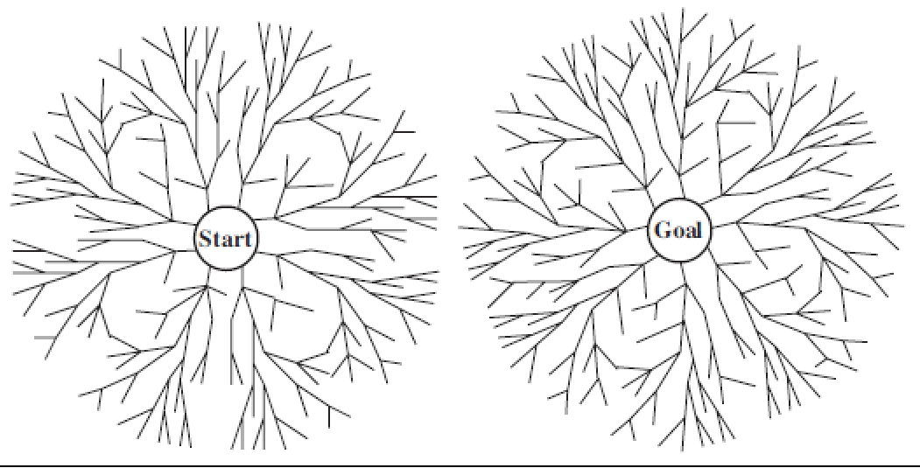
blind search ： some else
Bidirectional search
to run two simultaneous searches
one forward from the initial state
the other backward from the goal
the two searches meet in the middle

Slide 31
Heuristic Search: The general approach
best-first search
a node is selected for expansion based on an evaluation function f(n)
f(n) is construed as a cost estimate
the node with the lowest evaluation is expanded first
Open table uses evaluation function f to order the priority queue
Additional information is expressed by a heuristic function h(n)
h(n) = estimated cost of the cheapest path from the state at node n to a goal state
f(n) of most best-first algorithms include h(n) as a component

Slide 32
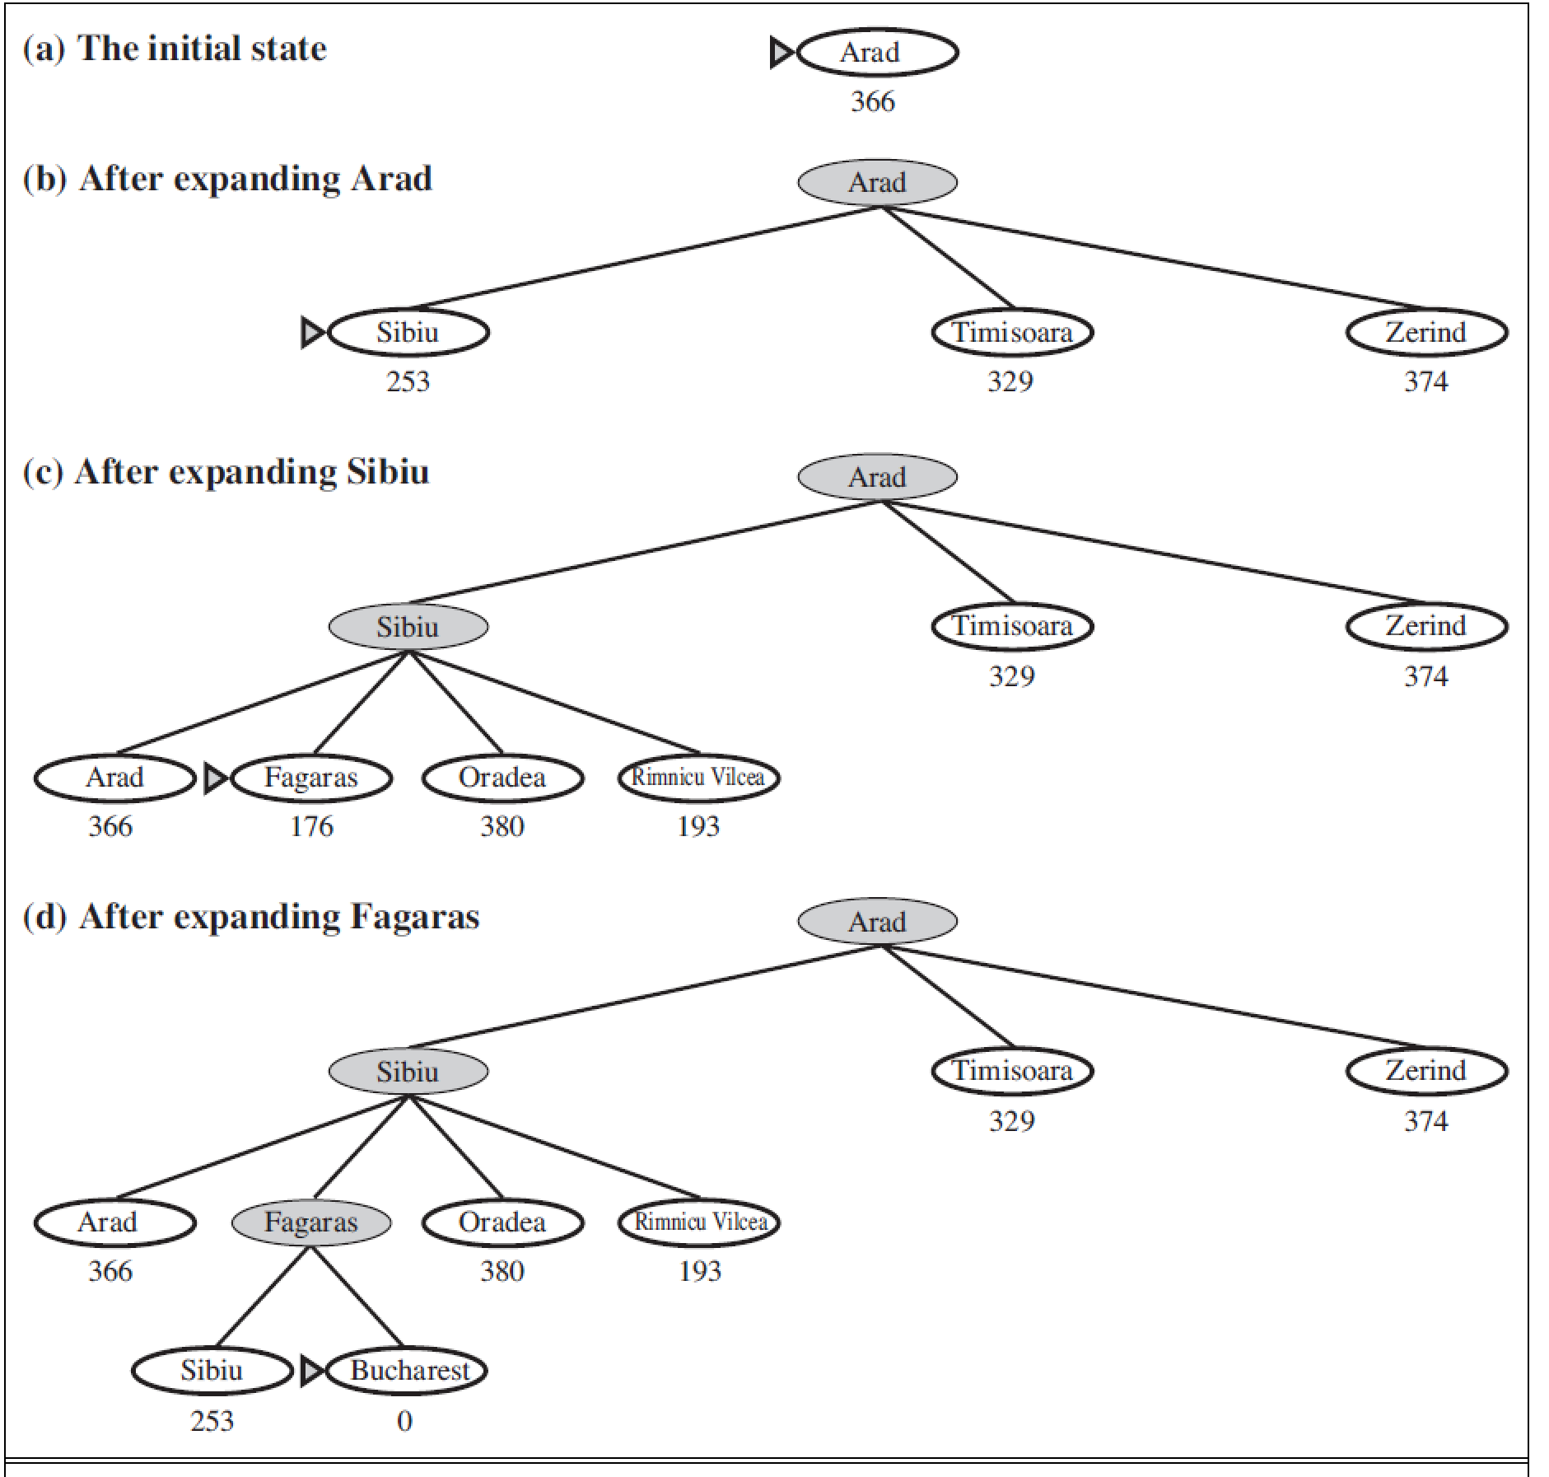
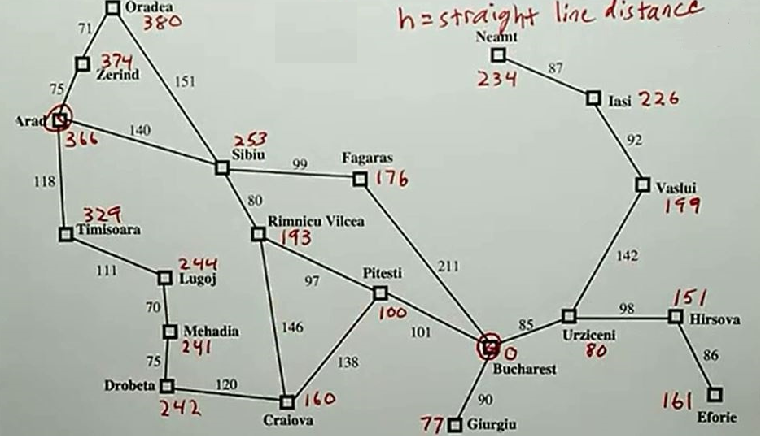
Heuristic Search: Greedy best-first search
It tries to expand the node that is closest to the goal
it evaluates nodes by using just the heuristic function
f(n) = h(n)

Slide 33
Heuristic Search: A Search
It evaluates nodes by combining g(n) and h(n)
f(n) = g(n)+h(n)
g(n): the cost to reach the node
h(n): the estimated cost from the node to the goal

Slide 34
Heuristic Search: A* Search
Given f*(n) = g*(n)+ h*(n), is cost minimum from initial node to goal node, where
g*(n) is cost minimum from initial node to node n
h*(n) is cost minimum from node n to goal node
If the evaluation function f = g + h in A search satisfy:
g(n) >0
h(n) is estimated value to h*(n) and h(n)≦h*(n)
The most widely known form of best-first search

Slide 35
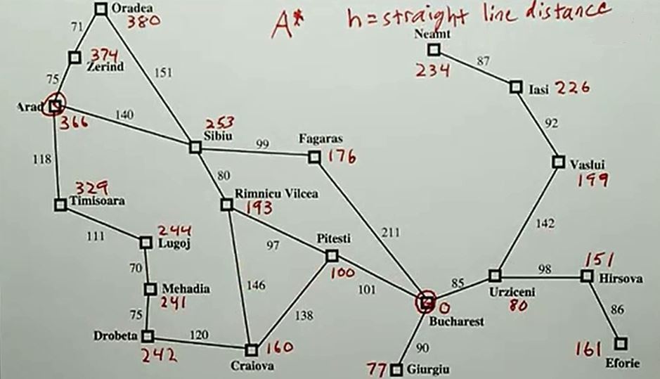
Example: A* Search

Slide 36
Example: A* Search
Arad
Open:
Arad(0+366)
Close:
Put initial node Arad to open table with g(0)+h(0)

Slide 37
Example: A* Search
Iterative deepening depth-ﬁrst search
Arad
Open:
Sibiu(393=140+253)
Timisoara(447=118+329)
Zerind(449=75+374)
Close:
Arad
Zerind
Sibiu
Timisoara
Expand Arad and put it’s descendent to open table
Reorder them by g(n)+h(n)

Slide 38
Example: A* Search
Iterative deepening depth-ﬁrst search
Arad
Open:
Rimnicu(413=220+193)
Fagras(415=239+176)
Timisoara(447=118+329)
Zerind(449=75+374)
Oradea(671=291+380)
Close:
Arad
Sibiu
Zerind
Sibiu
Timisoara
Oradea
Fagaras
Rimnicu
Expand Sibiu and put it’s descendent to open table
Reorder them by g(n)+h(n)

Slide 39
Example: A* Search
Expand Rimnicu and put it’s descendent to open table
Reorder them by g(n)+h(n)
Arad
Zerind
Sibiu
Timisoara
Open:
Fagras(415=239+176)
Pitesti(417=317+100)
Timisoara(447=118+329)
Zerind(449=75+374)
Craiova(526=366+160)
Oradea(671=291+380)
Close:
Arad
Sibiu
Rimnicu
Oradea
Fagaras
Rimnicu
Pitesti
Craiova

Slide 40
Example: A* Search
Expand Fagaras and put it’s descendent to open table
Reorder them by g(n)+h(n)
Arad
Zerind
Sibiu
Timisoara
Open:
Pitesti(417=317+100)
Timisoara(447=118+329)
Zerind(449=75+374)
Bucharest(450=450+0)
Craiova(526=366+160)
Oradea(671=291+380)
Close:
Arad
Sibiu
Rimnicu
Fagras
Oradea
Fagaras
Rimnicu
Pitesti
Bucharest
Craiova

Slide 41
Example: A* Search
Expand Pitesti
Modify paternity of it’s descendent
Reorder them by g(n)+h(n)
Arad
Zerind
Sibiu
Timisoara
Open:
Bucharest(450=450+0
, 418=418+0)
Timisoara(447=118+329)
Zerind(449=75+374)
Craiova(526=366+160)
Oradea(671=291+380)
Close:
Arad
Sibiu
Rimnicu
Fagras
Pitesti
Oradea
Fagaras
Rimnicu
Pitesti
Bucharest
Craiova

Slide 42
Example: A* Search
Get the goal node
Arad
Zerind
Sibiu
Timisoara
Open:
Bucharest(450=450+0
, 418=418+0)
Timisoara(447=118+329)
Zerind(449=75+374)
Craiova(526=366+160)
Oradea(671=291+380)
Close:
Arad
Sibiu
Rimnicu
Fagras
Pitesti
Oradea
Fagaras
Rimnicu
Pitesti
Bucharest
Craiova

Slide 43
BFS DFS A*
Optimal Solution
BFS: Shortest Steps
DFS: can not guarantee
Best First Search: least cost
A*: least cost with condition
Storage
 | Optimal | Storage
BFS | Y | 2^{n}
DFS | N | n
Best First | Y | 2^{n}
A* | Y | 2^{n} Better than Best First

Slide 44
A* - question
Does the Search stratage f=g+h always find the optimal solution ?
1 Yes, always.
2 No, depends on problem
3 No, depends on h

Slide 45
State Space
Introduction to Artificial Intelligence

Slide 46
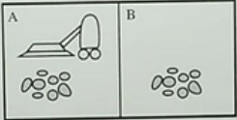
a example of Vacuum World
1, there are two rooms: A & B
2, clean or dirty for each room
3, Vacuum cleaner is in A or B
4, Vacuum cleaner can move from one room to another and can suck
How to describe the problem in state space?

Slide 47
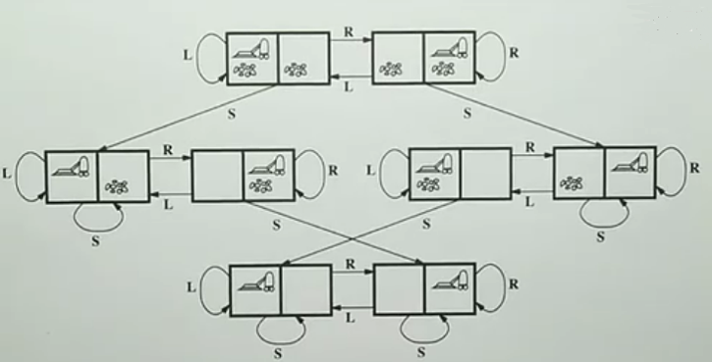
Describing Vacuum World in State Space
State Space
8 states
Actions
L = Left,
R= Right,
S= Suck.
Initial state
Goal state

Slide 48
How to design heuristic function
Let’s see a example of 8 puzzle
We can design heuristic function like
1, h1 = the number of misplaced blocks
2, h2 = the sum of distances each block have to move to the right position
These two approach are A* search

Slide 49
Discussion: where is the intelligence?
Introduction to Artificial Intelligence

Slide 50
Smart in A*
Compared to blind search, A* is viewed as “intelligence”.
It can get to the goal fast.(eg. Compare A* with BFS or Cheapest Cost)
But as we see, the heuristic information h is defined by human being.
The agent does not show the ability of finding the heuristic information.
Is it possible that the agent can find the heuristic information?

Slide 51
Principle of Restraint Relaxation for finding heuristic information
A block can move from square A to square B if (A is adjacent to B) and if (B is blank)
(to relax the restraint) →
A block can move from square A to square B if (A is adjacent to B) h2
(to relax the restraint) →
A block can move from square A to square B h1
h=max(h1, h2)

Slide 52
Conclusion – Problem Solving
What can search do?
Fully observable
we have to know the exact available actions
Discrete
Deterministic: we have to know the result of taking an action

Slide 53
Thank You !

